Slide 1
Combinational Logic
Pooja Thakkar
Assistant Professor, CE/IT
U. V. Patel College of Engineering(UVPCE), Ganpat University

Slide 2
Introduction
Consists of logic gates whose outputs, at any time, are determined by combining the values of the inputs.
For n input variables, there are 2^{n} possible binary input combinations.
For each binary combination of the input variables, there is one possible output.

Slide 3
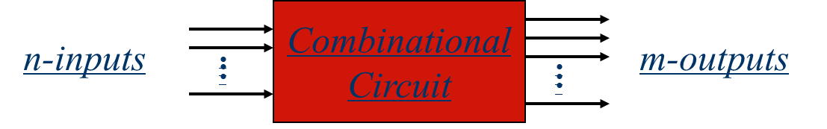
Introduction
Hence, a combinational circuit can be described by:
A truth table that lists the output values for each combination of the input variables, or
m Boolean functions, one for each output variable.

Slide 4
Introduction
n-inputs
Combinational
Circuit
m-outputs
(Depend only on inputs)
Combinational Circuit
n-inputs
m-outputs
Combinational
Circuit
Storage
Elements
Next
state
Present
state
Sequential Circuit

Slide 5
Design Procedure
State the problem.
Determine the required number of inputs and outputs and assign a symbol to each.
Derive the truth table that defines the required relationship between inputs and outputs.
Obtain the simplified Boolean functions for each output.
Draw the logic diagram.

Slide 6
Adders
The most basic arithmetic operation is the addition of two binary digits.
Combination circuit that performs the addition of two bits is half adder
Adder that performs the addition of 2 significant bits and a previous carry is called a full adder

Slide 7
Half adder
Inputs: x and y
Outputs: S (for sum) and C (for carry)
x | y | C | S
0 | 0 | 0 | 0
0 | 1 | 0 | 1
1 | 0 | 0 | 1
1 | 1 | 1 | 0
S = x’y + xy’
C = xy

Slide 8
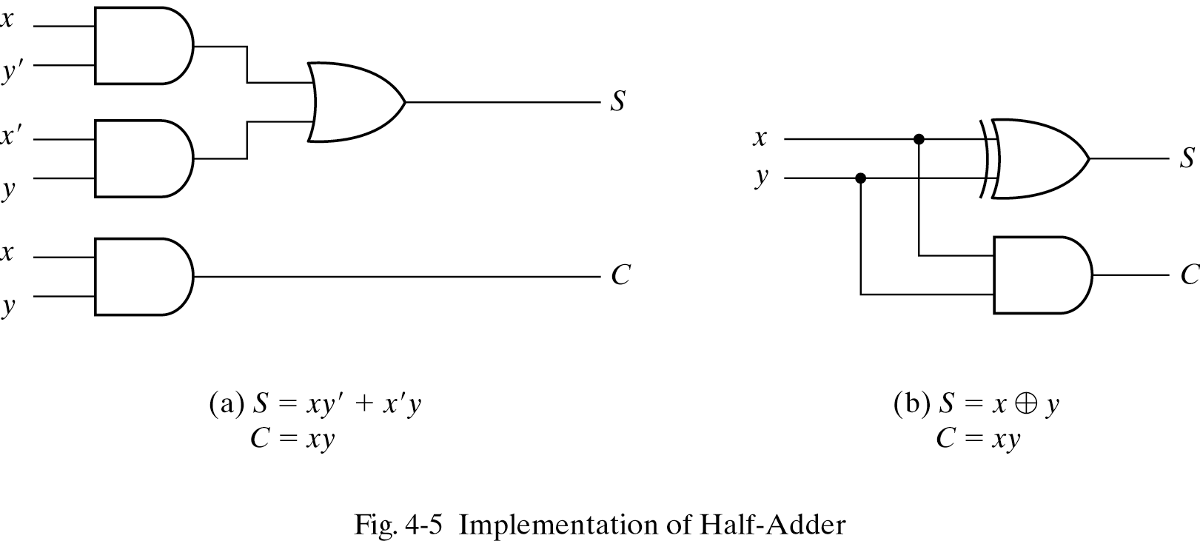
Implementation of a Half Adder

Slide 9
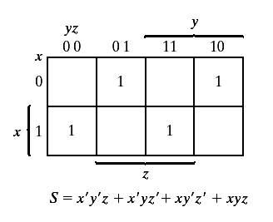
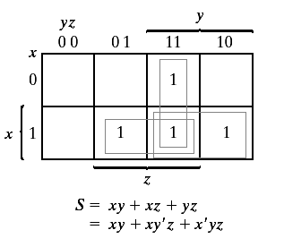

Full Adder
x | y | z | C | S
0 | 0 | 0 | 0 | 0
0 | 0 | 1 | 0 | 1
0 | 1 | 0 | 0 | 1
0 | 1 | 1 | 1 | 0
1 | 0 | 0 | 0 | 1
1 | 0 | 1 | 1 | 0
1 | 1 | 0 | 1 | 0
1 | 1 | 1 | 1 | 1
C

Slide 10
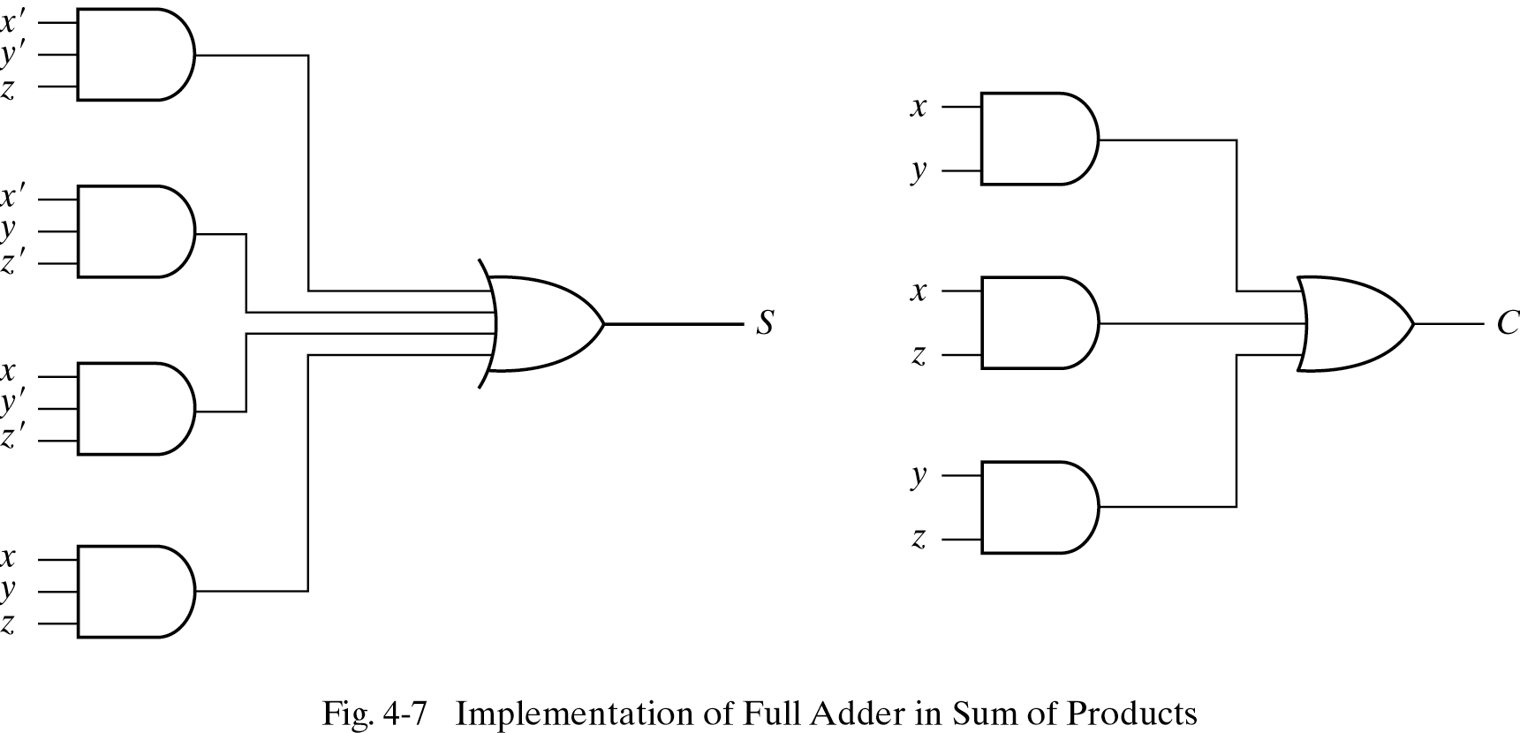
Implementation of a Full Adder
S = x ' y ' z + x 'yz ' + xy ' z ' +xyz
C= xy + xz +yz

Slide 11
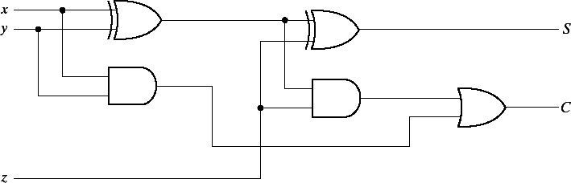
Implementation of a Full Adder
A full adder can be implemented with two half adders and an OR gate
S = xy’z’ + x’yz’ + xyz + x’y’z
= z’(xy’ + x’y) + z(xy’ + x’y)’
= z ⊕ (x ⊕ y)
C = xy’z + x’yz + xy
= z(xy’ + x’y) + xy

Slide 12
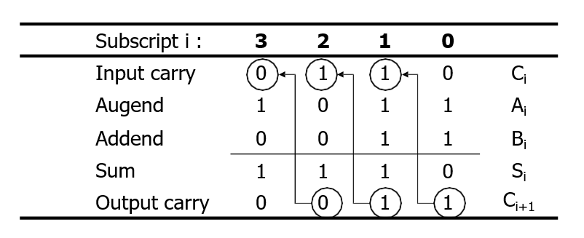
4-bit Binary Adder
Consider two binary number
A = 1011 and B = 0011

Slide 13
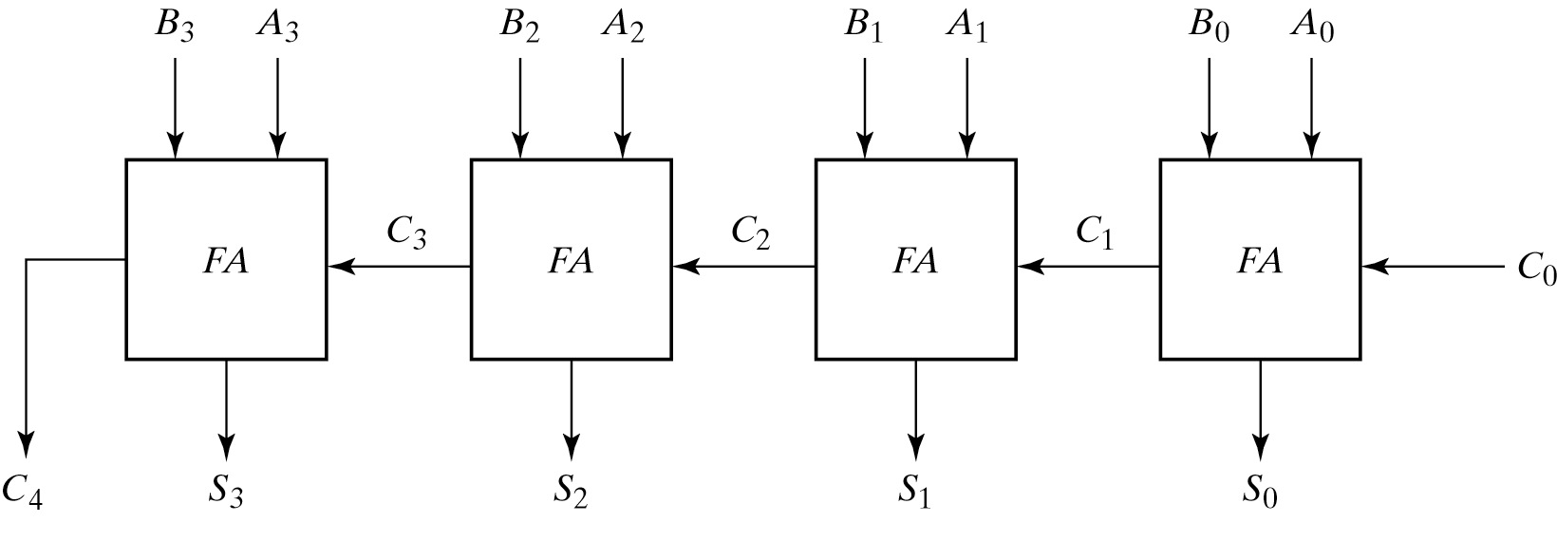
4-bit Binary Adder

Slide 14
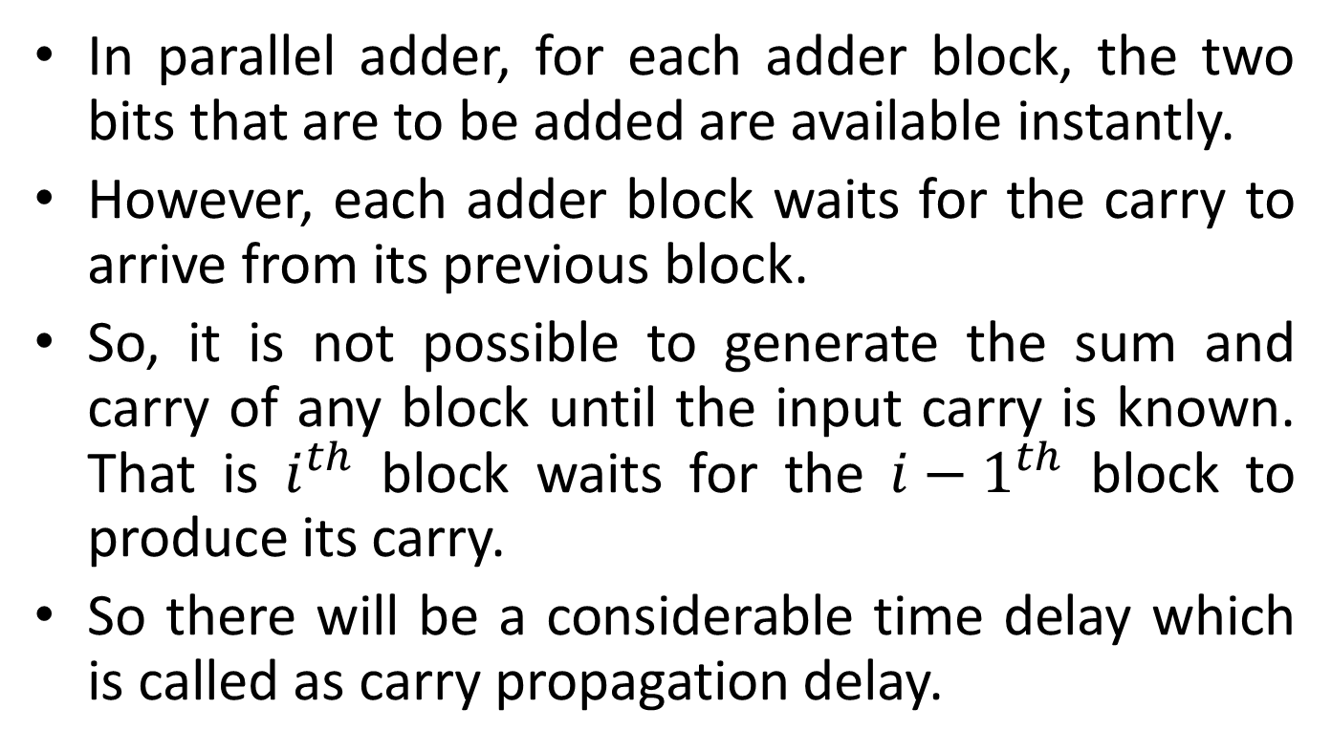
Carry Propagation
In parallel adder, for each adder block, the two bits that are to be added are available instantly.
However, each adder block waits for the carry to arrive from its previous block.
So, it is not possible to generate the sum and carry of any block until the input carry is known. That is $i^{th}$ block waits for the ${i−1}^{th}$ block to produce its carry.
So there will be a considerable time delay which is called as carry propagation delay.

Slide 15
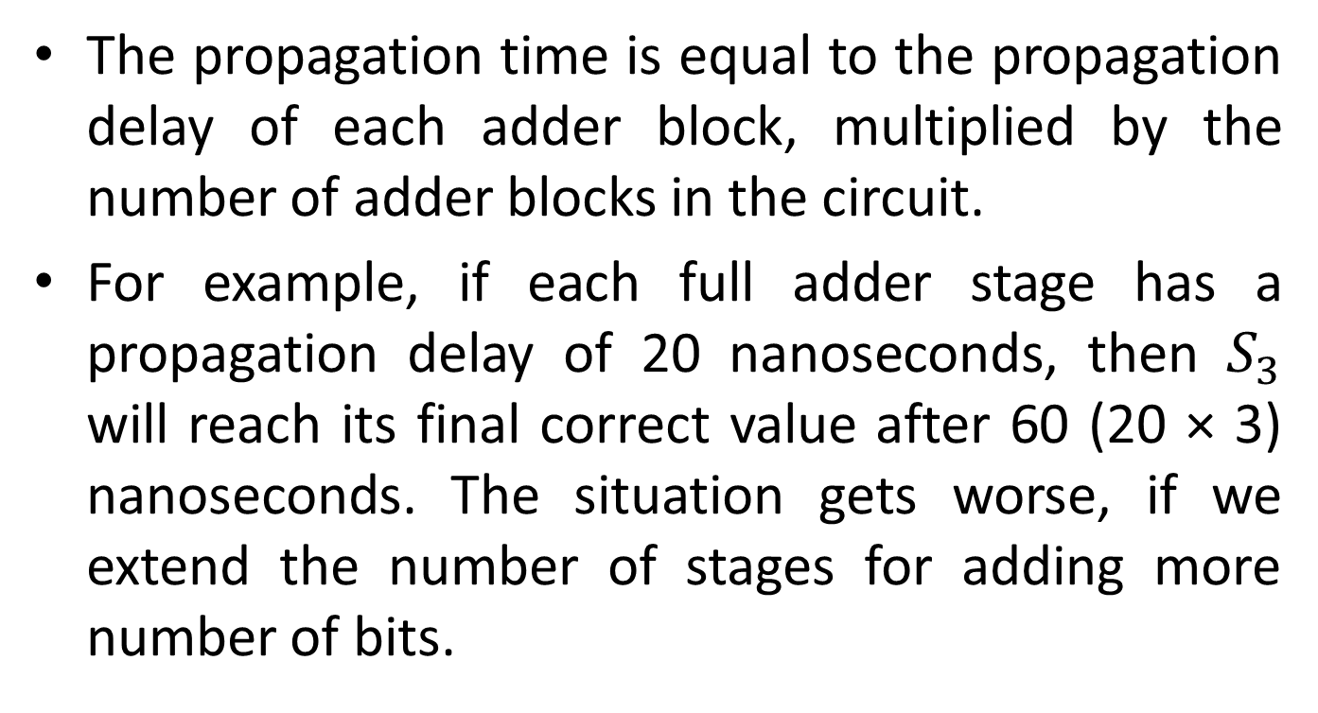
Carry Propagation
The propagation time is equal to the propagation delay of each adder block, multiplied by the number of adder blocks in the circuit.
For example, if each full adder stage has a propagation delay of 20 nanoseconds, then $S_{3}$ will reach its final correct value after 60 (20 × 3) nanoseconds. The situation gets worse, if we extend the number of stages for adding more number of bits.

Slide 16
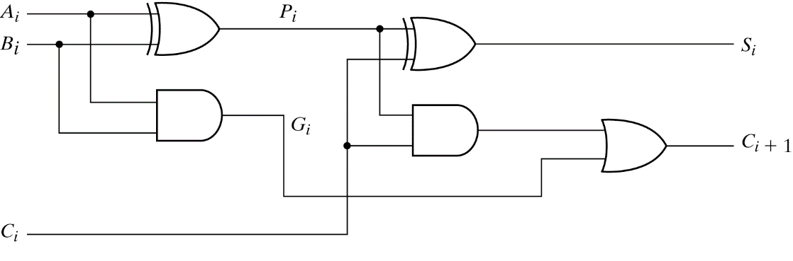
Look-ahead Carry Generator
P_{i} = A_{i} ⊕ B_{i}
G_{i} = A_{i}B_{i}
Output sum and carry
S_{i} = P_{i} ⊕ C_{i}
C_{i+1} = G_{i} + P_{i}C_{i}
G_{i} : carry generate P_{i} : carry propagate
C₀ = input carry
C₁ = G₀ + P₀C₀
C₂ = G₁ + P₁C₁ = G₁ + P₁G₀ + P₁P₀C₀
C₃ = G₂ + P₂C₂ = G₂ + P₂G₁ + P₂P₁G₀ + P₂P₁P₀C₀
C₃ does not have to wait for C₂ and C₁ to propagate.

Slide 17
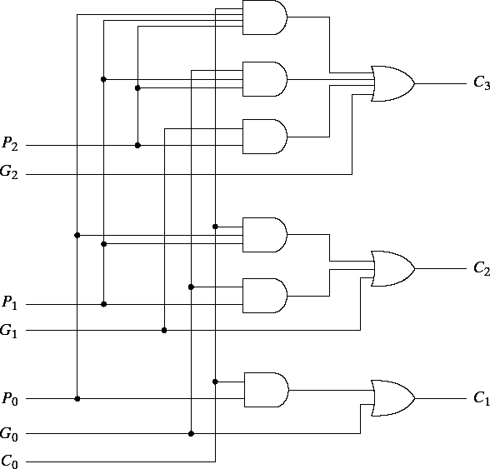
Look-ahead Carry Generator

Slide 18
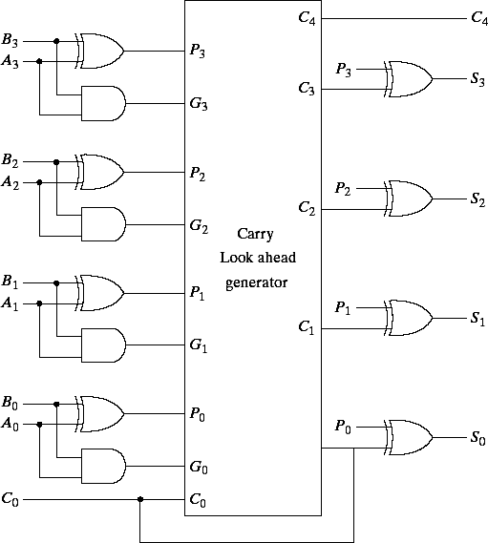
4-bit Full-adder with look-ahead carry

Slide 19
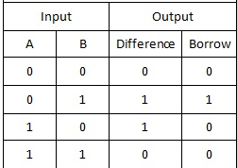
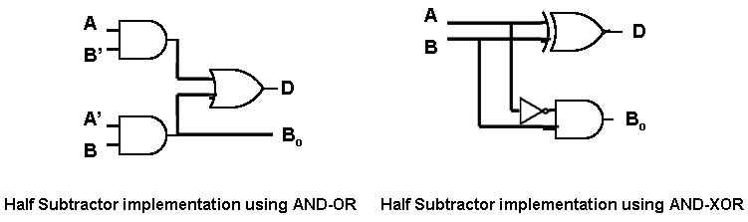
Half Subtractor
Diff = A’B+AB’
Borrow = A’B

Slide 20
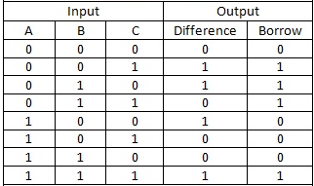
Full Subtractor
One that performs the subtraction of three bits is a full subtractor.

Slide 21
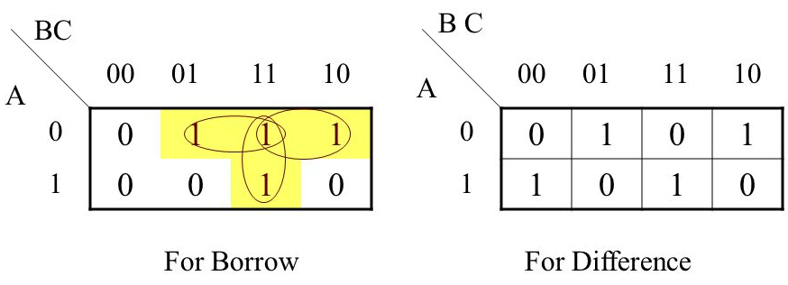
Full Subtractor
D = A’B’C+A’BC’+AB’C’+ABC
C = A’C+A’B+BC

Slide 22
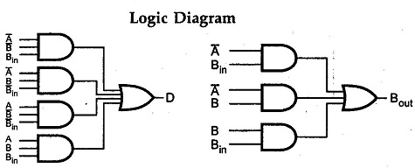
Full Subtractor

Slide 23
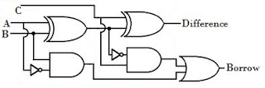
Full Subtractor
Full-subtractor can also be implemented with two half subtractor and one OR gate.

Slide 24
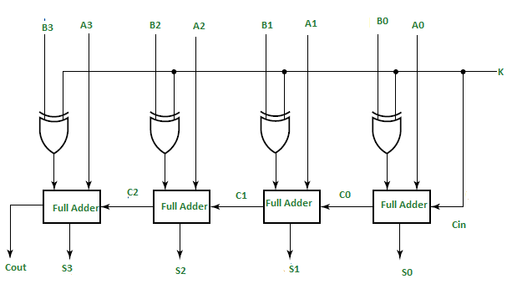
4-bit Adder-Subtractor
K=0 (Adder)
Input of FA is A and B (B 0 = B), and C0 is 0
K=1 (Subtractor)
Input of FA is A and B' (B 1 = B'), and C0 is 1

Slide 25
BCD Adder
BCD adder
Perform the addition of two decimal digits in BCD, together with an input carry from a previous stage
BCD adder requires minimum of 9 inputs & 5 outputs
1 digit requires 4-bit
Input: 2 digits + 1-bit carry
Output: 1 digit + 1-bit carry
The output sum cannot be greater than 19 (9+9+1)

Slide 26
BCD Adder
When the binary sum is equal to or less than 1001 in Binary
BCD Sum = Binary Sum
C = 0
When the binary sum is greater than 1001 in Binary
BCD Sum = Binary Sum + 0110b
C = 1

Slide 27
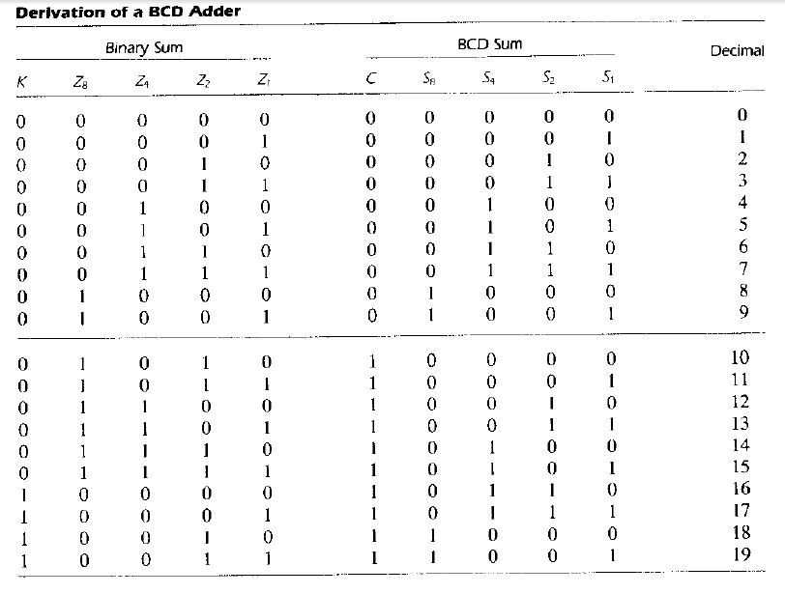
BCD Adder

Slide 28
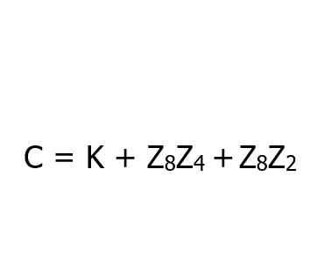


BCD Adder
$$Z_{2}Z_{1}$$
$$Z_{8}Z_{4}$$
1 | 1 | 1 | 1
 |  | 1 | 1

Slide 29
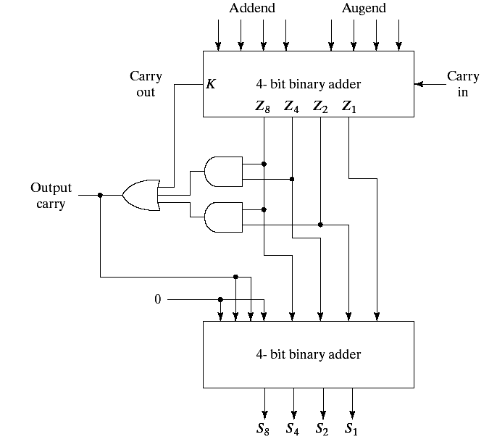
BCD Adder Implementation
C = K + Z8Z4 + Z8Z2
If C =1 , it is necessary
to add 0110 to binary sum

Slide 30
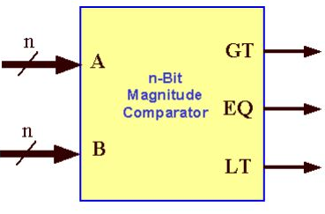
Magnitude Comparator
Combinational circuit that compares two digital or binary numbers and find out whether one number is equal, less than or greater than the other number.
3 binary variables are used to indicate the outcome as A>B, A<B, or A=B.

Slide 31
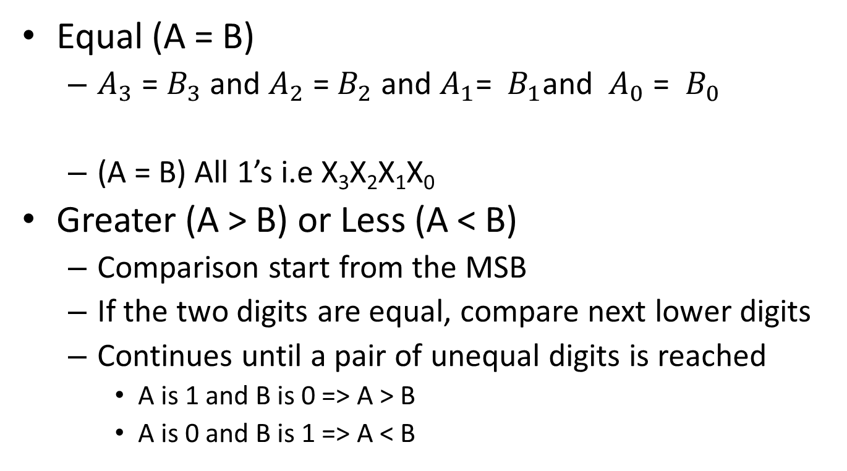
4 Bit Magnitude Comparator
Equal (A = B)
$A_{3}$ = $B_{3}$ and $A_{2}$ = $B_{2}$ and $A_{1}$= ${ B}_{1}$and ${ A}_{0}$ = ${ B}_{0}$
(A = B) All 1’s i.e X₃X₂X₁X₀
Greater (A > B) or Less (A < B)
Comparison start from the MSB
If the two digits are equal, compare next lower digits
Continues until a pair of unequal digits is reached
A is 1 and B is 0 => A > B
A is 0 and B is 1 => A < B
Xi = AiBi + Ai'Bi' for i = 0,1,2,3
(A > B) = A3B3' + X3A2B2'+ X3X2A1B1' + X3X2X1A0B0'
(A < B) = A3'B3 + X3A2' B2+ X3X2A1' B1 + X3X2X1A0' B0

Slide 32
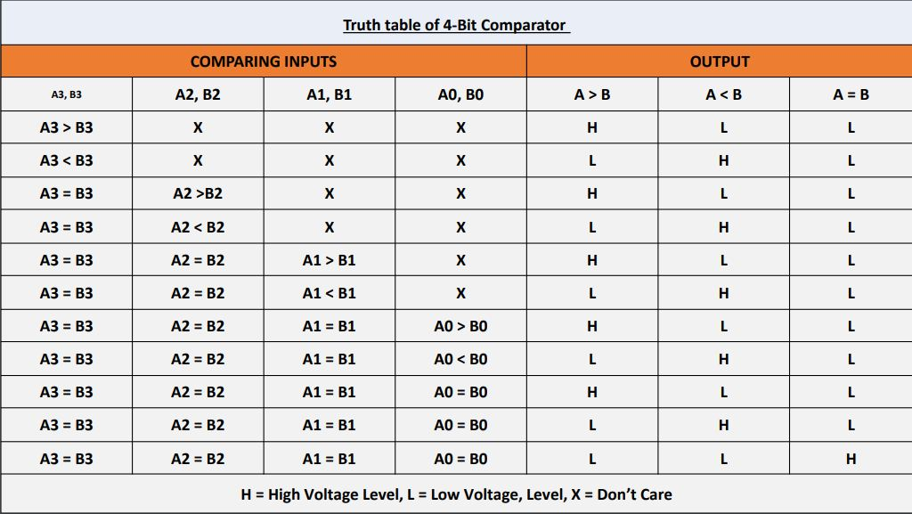
4 Bit Magnitude Comparator

Slide 33
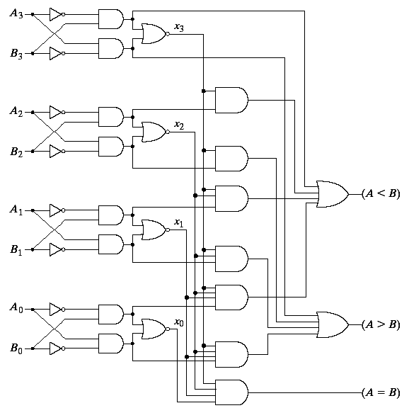
4 Bit Magnitude Comparator

Slide 34
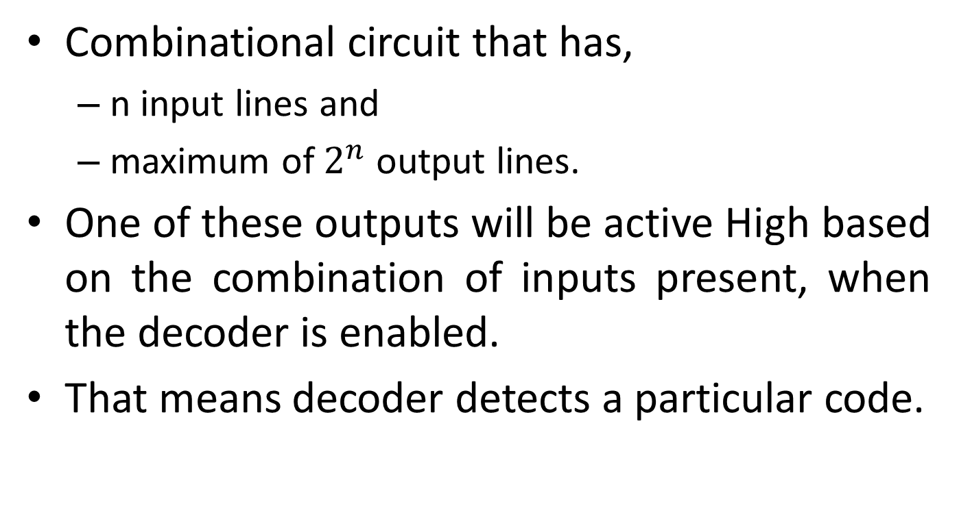
Decoder
Combinational circuit that has,
n input lines and
maximum of $2^{n}$ output lines.
One of these outputs will be active High based on the combination of inputs present, when the decoder is enabled.
That means decoder detects a particular code.

Slide 35
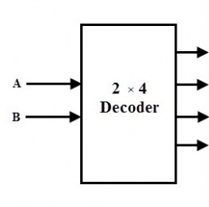

2 x 4 Decoder
Y0
Y1
Y2
EN
Y3
EN | A | B | Y0 | Y1 | Y2 | Y3
0 | X | X | 0 | 0 | 0 | 0
1 | 0 | 0 | 1 | 0 | 0 | 0
1 | 0 | 1 | 0 | 1 | 0 | 0
1 | 1 | 0 | 0 | 0 | 1 | 0
1 | 1 | 1 | 0 | 0 | 0 | 1

Slide 36
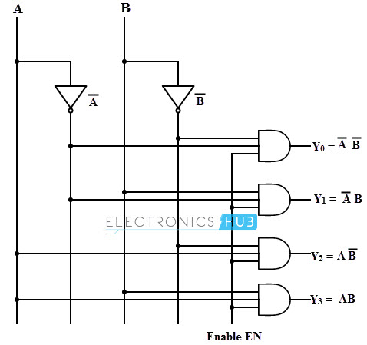
2 x 4 Decoder

Slide 37
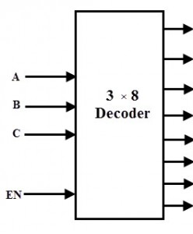
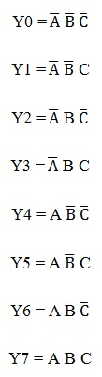
3 x 8 Decoder
Y0
Y1
Y2
Y3
Y4
Y5
EN | A | B | C | Y0 | Y1 | Y2 | Y3 | Y4 | Y5 | Y6 | Y7
0 | X | X | X | 0 | 0 | 0 | 0 | 0 | 0 | 0 | 0
1 | 0 | 0 | 0 | 1 | 0 | 0 | 0 | 0 | 0 | 0 | 0
1 | 0 | 0 | 1 | 0 | 1 | 0 | 0 | 0 | 0 | 0 | 0
1 | 0 | 1 | 0 | 0 | 0 | 1 | 0 | 0 | 0 | 0 | 0
1 | 0 | 1 | 1 | 0 | 0 | 0 | 1 | 0 | 0 | 0 | 0
1 | 1 | 0 | 0 | 0 | 0 | 0 | 0 | 1 | 0 | 0 | 0
1 | 1 | 0 | 1 | 0 | 0 | 0 | 0 | 0 | 1 | 0 | 0
1 | 1 | 1 | 0 | 0 | 0 | 0 | 0 | 0 | 0 | 1 | 0
1 | 1 | 1 | 1 | 0 | 0 | 0 | 0 | 0 | 0 | 0 | 1
Y6
Y7

Slide 38
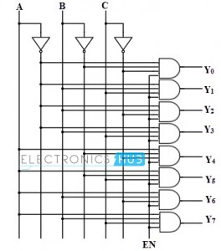
3 x 8 Decoder

Slide 39
4 x 16 Decoder
D | A | B | C | Y0 | Y1 | Y2 | Y3 | Y4 | Y5 | Y6 | Y7 | Y8 | Y9 | Y10 | Y11 | Y12 | Y13 | Y14 | Y15
0 | 0 | 0 | 0 | 1 | 0 | 0 | 0 | 0 | 0 | 0 | 0 | 0 | 0 | 0 | 0 | 0 | 0 | 0 | 0
0 | 0 | 0 | 1 | 0 | 1 | 0 | 0 | 0 | 0 | 0 | 0 | 0 | 0 | 0 | 0 | 0 | 0 | 0 | 0
0 | 0 | 1 | 0 | 0 | 0 | 1 | 0 | 0 | 0 | 0 | 0 | 0 | 0 | 0 | 0 | 0 | 0 | 0 | 0
0 | 0 | 1 | 1 | 0 | 0 | 0 | 1 | 0 | 0 | 0 | 0 | 0 | 0 | 0 | 0 | 0 | 0 | 0 | 0
0 | 1 | 0 | 0 | 0 | 0 | 0 | 0 | 1 | 0 | 0 | 0 | 0 | 0 | 0 | 0 | 0 | 0 | 0 | 0
0 | 1 | 0 | 1 | 0 | 0 | 0 | 0 | 0 | 1 | 0 | 0 | 0 | 0 | 0 | 0 | 0 | 0 | 0 | 0
0 | 1 | 1 | 0 | 0 | 0 | 0 | 0 | 0 | 0 | 1 | 0 | 0 | 0 | 0 | 0 | 0 | 0 | 0 | 0
0 | 1 | 1 | 1 | 0 | 0 | 0 | 0 | 0 | 0 | 0 | 1 | 0 | 0 | 0 | 0 | 0 | 0 | 0 | 0
1 | 0 | 0 | 0 | 0 | 0 | 0 | 0 | 0 | 0 | 0 | 0 | 1 | 0 | 0 | 0 | 0 | 0 | 0 | 0
1 | 0 | 0 | 1 | 0 | 0 | 0 | 0 | 0 | 0 | 0 | 0 | 0 | 1 | 0 | 0 | 0 | 0 | 0 | 0
1 | 0 | 1 | 0 | 0 | 0 | 0 | 0 | 0 | 0 | 0 | 0 | 0 | 0 | 1 | 0 | 0 | 0 | 0 | 0
1 | 0 | 1 | 1 | 0 | 0 | 0 | 0 | 0 | 0 | 0 | 0 | 0 | 0 | 0 | 1 | 0 | 0 | 0 | 0
1 | 1 | 0 | 0 | 0 | 0 | 0 | 0 | 0 | 0 | 0 | 0 | 0 | 0 | 0 | 0 | 1 | 0 | 0 | 0
1 | 1 | 0 | 1 | 0 | 0 | 0 | 0 | 0 | 0 | 0 | 0 | 0 | 0 | 0 | 0 | 0 | 1 | 0 | 0
1 | 1 | 1 | 0 | 0 | 0 | 0 | 0 | 0 | 0 | 0 | 0 | 0 | 0 | 0 | 0 | 0 | 0 | 1 | 0
1 | 1 | 1 | 1 | 0 | 0 | 0 | 0 | 0 | 0 | 0 | 0 | 0 | 0 | 0 | 0 | 0 | 0 | 0 | 1

Slide 40
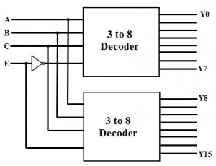
4 x 16 Decoder

Slide 41
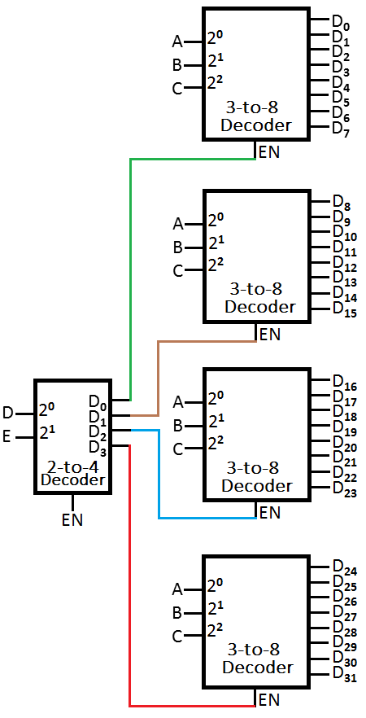
5 x 32 Decoder

Slide 42
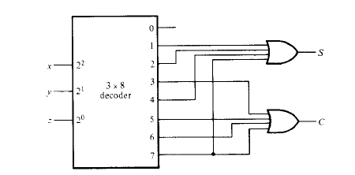
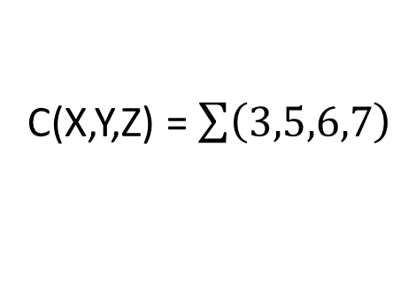
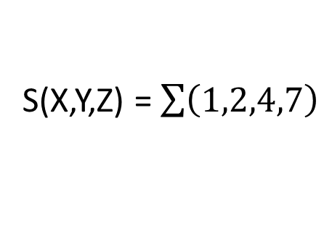
Example
Implement full adder circuit with a decoder and two OR gate.
S(X,Y,Z) = $\sum{\left(1,2,4,7\right)}$
X | Y | Z | C | S
0 | 0 | 0 | 0 | 0
0 | 0 | 1 | 0 | 1
0 | 1 | 0 | 0 | 1
0 | 1 | 1 | 1 | 0
1 | 0 | 0 | 0 | 1
1 | 0 | 1 | 1 | 0
1 | 1 | 0 | 1 | 0
1 | 1 | 1 | 1 | 1
C(X,Y,Z) = $\sum{\left(3,5,6,7\right)}$

Slide 43
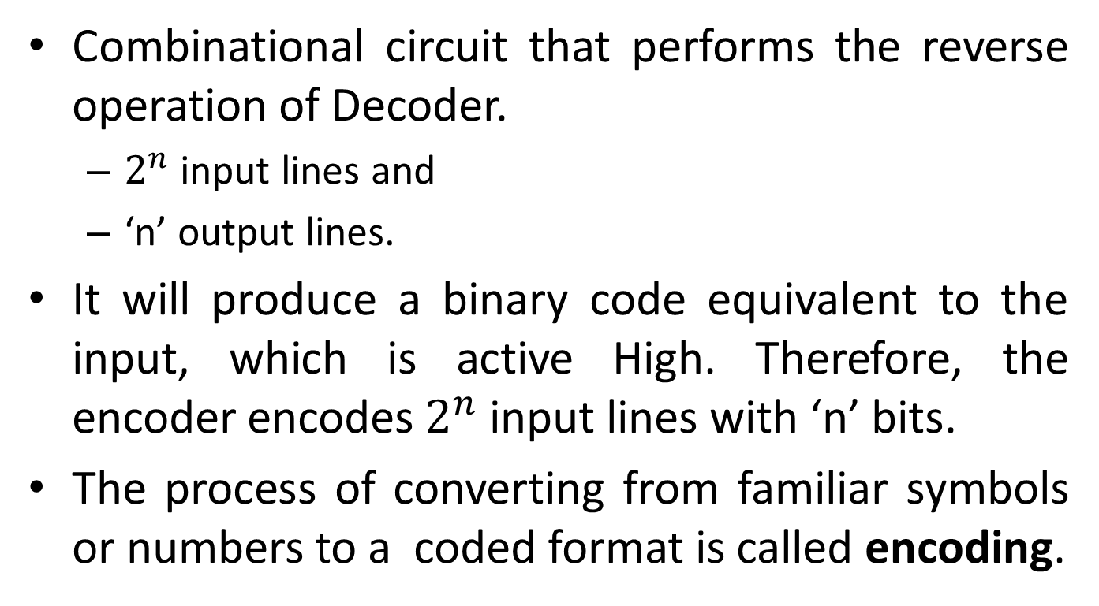
Encoder
Combinational circuit that performs the reverse operation of Decoder.
$2^{n}$ input lines and
‘n’ output lines.
It will produce a binary code equivalent to the input, which is active High. Therefore, the encoder encodes $2^{n}$ input lines with ‘n’ bits.
The process of converting from familiar symbols or numbers to a coded format is called encoding.

Slide 44
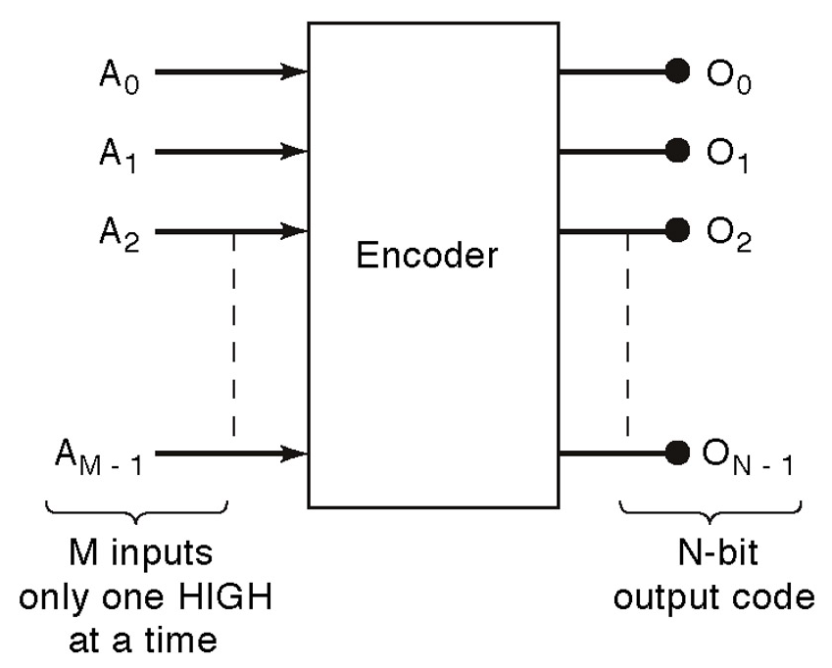
Encoder

Slide 45
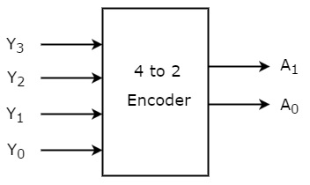
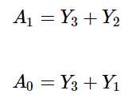
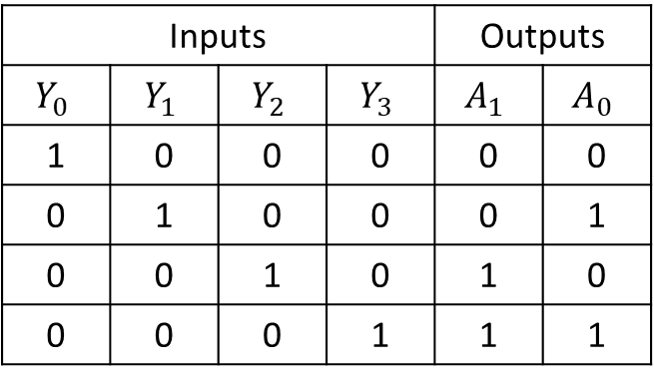
4 x 2 Encoder
Inputs |  |  |  | Outputs
$$Y_{0}$$ | $$Y_{1}$$ | $$Y_{2}$$ | $$Y_{3}$$ | $$A_{1}$$ | $$A_{0}$$
1 | 0 | 0 | 0 | 0 | 0
0 | 1 | 0 | 0 | 0 | 1
0 | 0 | 1 | 0 | 1 | 0
0 | 0 | 0 | 1 | 1 | 1

Slide 46
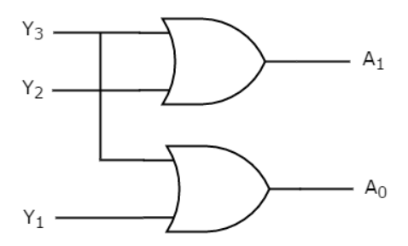
4 x 2 Encoder

Slide 47
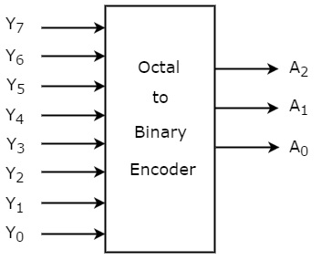
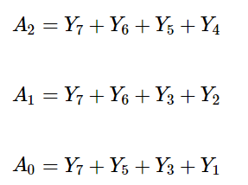
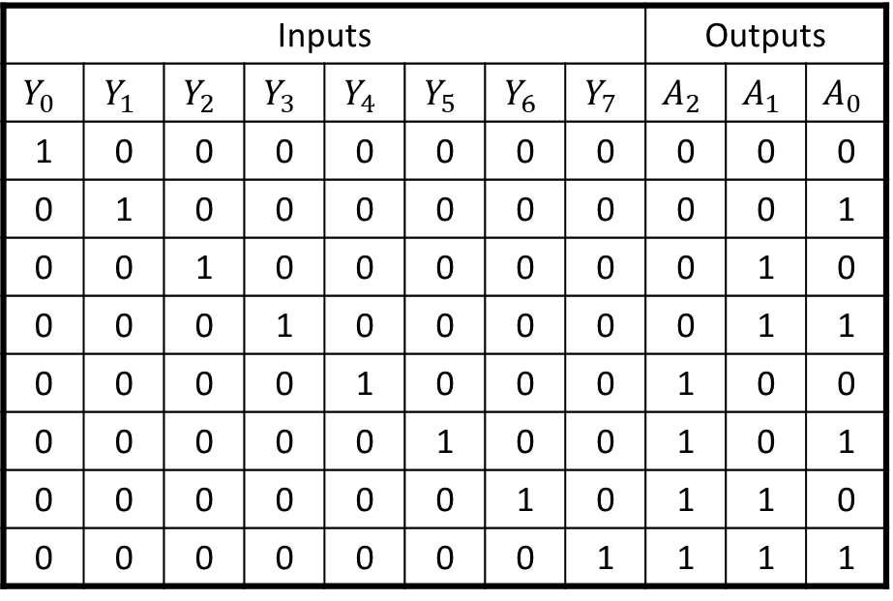
8 x 3 Encoder
Inputs |  |  |  |  |  |  |  | Outputs
$$Y_{0}$$ | $$Y_{1}$$ | $$Y_{2}$$ | $$Y_{3}$$ | $$Y_{4}$$ | $$Y_{5}$$ | $$Y_{6}$$ | $$Y_{7}$$ | $$A_{2}$$ | $$A_{1}$$ | $$A_{0}$$
1 | 0 | 0 | 0 | 0 | 0 | 0 | 0 | 0 | 0 | 0
0 | 1 | 0 | 0 | 0 | 0 | 0 | 0 | 0 | 0 | 1
0 | 0 | 1 | 0 | 0 | 0 | 0 | 0 | 0 | 1 | 0
0 | 0 | 0 | 1 | 0 | 0 | 0 | 0 | 0 | 1 | 1
0 | 0 | 0 | 0 | 1 | 0 | 0 | 0 | 1 | 0 | 0
0 | 0 | 0 | 0 | 0 | 1 | 0 | 0 | 1 | 0 | 1
0 | 0 | 0 | 0 | 0 | 0 | 1 | 0 | 1 | 1 | 0
0 | 0 | 0 | 0 | 0 | 0 | 0 | 1 | 1 | 1 | 1

Slide 48
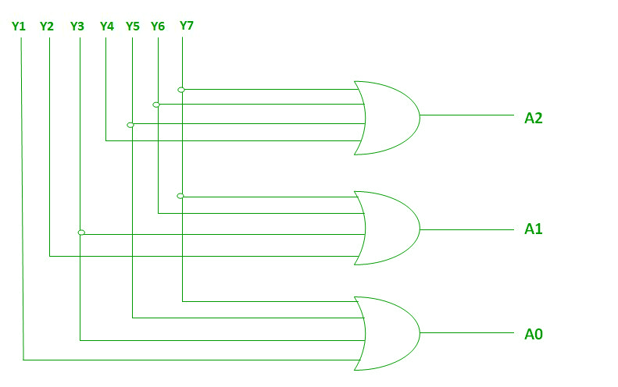
8 x 3 Encoder

Slide 49
Multiplexer
Circuit that has multiple inputs and a single output.
Selection of one of ‘n’ inputs is done by select lines
It has one output selected at a time.
Also known as DATA SELECTOR.
A multiplexer has
- N data inputs (multiple)
- 1 output (single)
- M select inputs, with 2^{M} =N

Slide 50
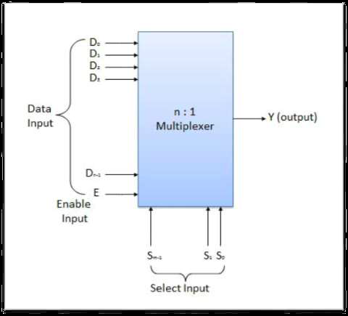
Block Diagram of Multiplexer

Slide 51
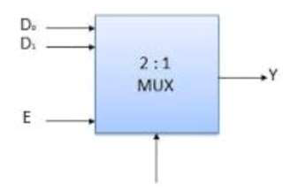


2 to 1 line Multiplexer
Y=D0S’+D1S

Slide 52



4 to 1 line Multiplexer
Y=S1’S0’D0+S1’S0D1+S1S0’D2+S1S0D3

Slide 53


8 to 1 line Multiplexer
Y=S2’S1’S0’D0+S2’S1’S0D1+S2’S1S0’D2+S2’S1S0D3
+S2S1’S0’D4+S2S1’S0D5+S2S1S0’D6+S2S1S0D7

Slide 54

8 to 1 line Multiplexer
Y
S1
S0
S2

Slide 55


Examples
Implement following function with a Multiplexer.
F(A,B,C) = $\sum{\left(1,3,5,6\right)}$
 | D0 | D1 | D2 | D3
A’ | 0 | 1 | 2 | 3
A | 4 | 5 | 6 | 7
Minterm | A | B | C | F
0 | 0 | 0 | 0 | 0
1 | 0 | 0 | 1 | 1
2 | 0 | 1 | 0 | 0
3 | 0 | 1 | 1 | 1
4 | 1 | 0 | 0 | 0
5 | 1 | 0 | 1 | 1
6 | 1 | 1 | 0 | 1
7 | 1 | 1 | 1 | 0

Slide 56


Examples
Implement following function with a Multiplexer. Keep A,B as Selection lines and use 4*1 Multiplexer
F(A,B,C) = $\sum{\left(1,2,4,5\right)}$
Minterm | A | B | C | F
0 | 0 | 0 | 0 | 0
1 | 0 | 0 | 1 | 1
2 | 0 | 1 | 0 | 1
3 | 0 | 1 | 1 | 0
4 | 1 | 0 | 0 | 1
5 | 1 | 0 | 1 | 1
6 | 1 | 1 | 0 | 0
7 | 1 | 1 | 1 | 0
 | D0 | D1 | D2 | D3
C’ | 0 | 2 | 4 | 6
C | 1 | 3 | 5 | 7

Slide 57


Examples
Implement following function with a Multiplexer.
F(A,B,C,D) = $\sum{\left(0,1,3,4,8,9,15\right)}$
 | D0 | D1 | D2 | D3 | D4 | D5 | D6 | D7
A’ | 0 | 1 | 2 | 3 | 4 | 5 | 6 | 7
A | 8 | 9 | 10 | 11 | 12 | 13 | 14 | 15

Slide 58

De-multiplexer
Combinational Circuit with one input and multiple output lines.
Types :
1 to 2 Line De-multiplexer (Selection lines = 1)
1 to 4 Line De-multiplexer (Selection lines = 2)
1 to 8 Line De-multiplexer (Selection lines = 3)

Slide 59

1 to 8 line De-multiplexer

